Slide 1
Statistical simulations and considerations

Slide 2
Goals
Lab common standards and understanding of generalized linear models (GLM).
Further understanding without heavy math.

Slide 3
Overview
Transformations and data
Distributions
Simulations
What I do when modeling
Model comparison

Slide 4
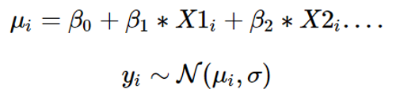
Modeling different forms of dependent variables
What is regression and how I think about regression problems.

Slide 5
Modeling different forms of dependent variables
What is regression and how I think about regression problems.
Commonly encountered bounds of dependent variables:
[-inf ; inf]
[0 ; inf] (RTs)
[a ; b] (VAS-ratings)

Slide 6
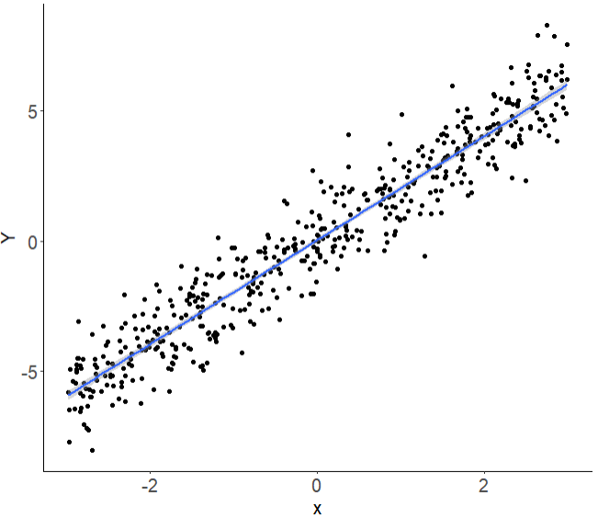
What does this mean?
[-inf ; inf]
Notes:
One unit increase in x is a B1 increase in Y

Slide 7
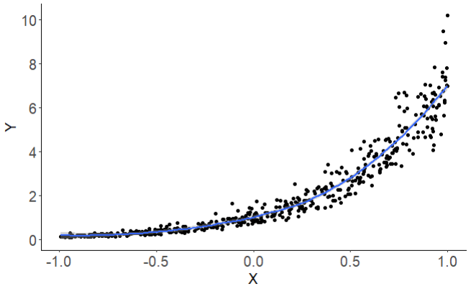


What does this mean?
[-inf ; inf]
[0 ; inf]

Slide 8
What does this mean?
[0 ; inf]
Notes:
A one unit increase in X is a exp(b1)-1 % increase in Y. here exp(2) = 7.3-1 = 6.3*100 = 630 % increase in y.

Slide 9
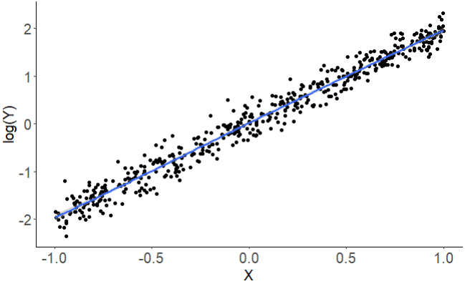

What does this mean?
[0 ; inf]
[-inf ; inf]

Slide 10
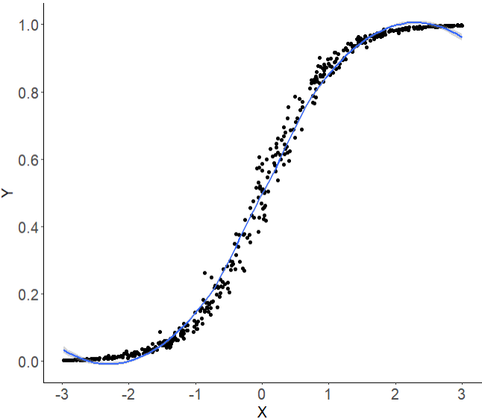



What does this mean?
[0 ; 1]

Slide 11

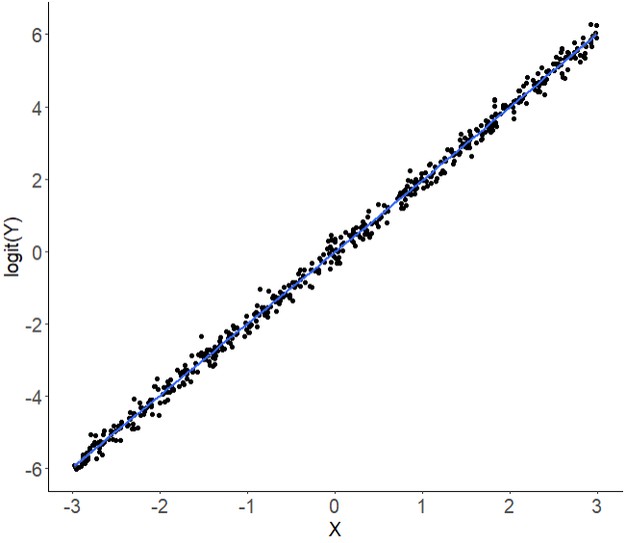

What does this mean?
[0 ; 1]
[-inf ; inf]
Notes:
a 1 unit increase in ₁ will result in b1 increase in the log odds of y (log odds = logit)

Slide 12
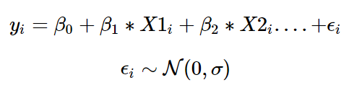
Regression as distributions

Slide 13
Regression as distributions

Slide 14
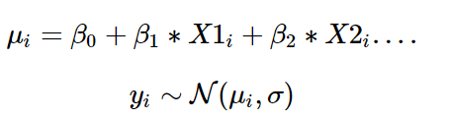
Regression as distributions

Slide 15
Why the normal distribution and does it matter?
App
Notes:
https://en.wikipedia.org/wiki/Exponential_family

Slide 16
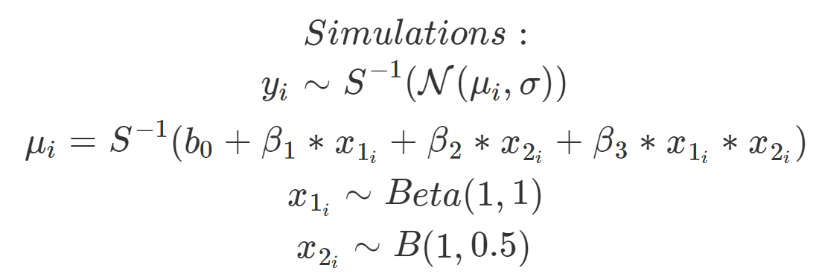
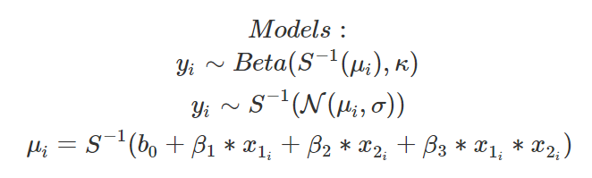

Comparing bounded distributions! (VAS)
Notes:
https://lindeloev.github.io/shiny-rt/ https://stats.stackexchange.com/questions/67547/when-to-use-gamma-glms

Slide 17
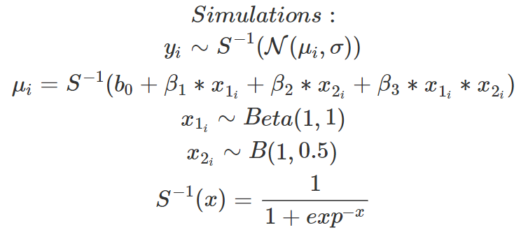
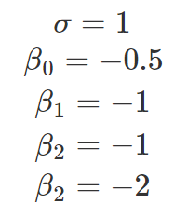
Example:

Slide 18
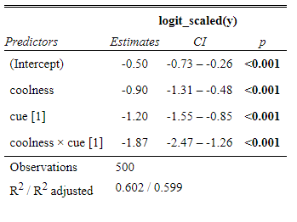
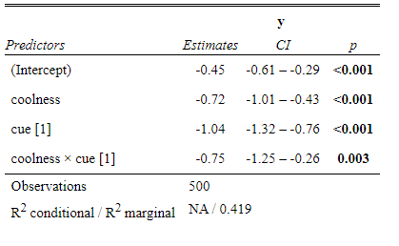
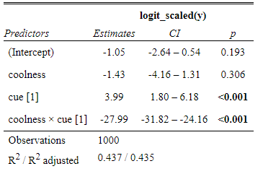
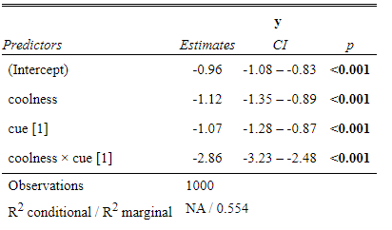
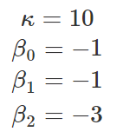
Example:
1
7.3

Slide 19
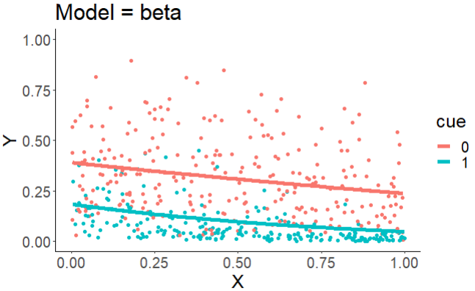
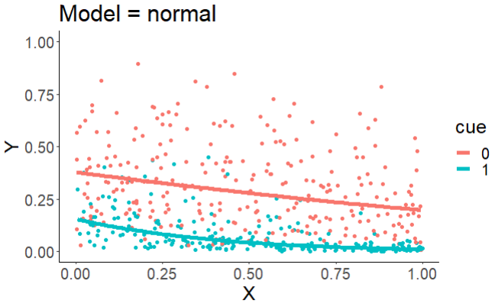
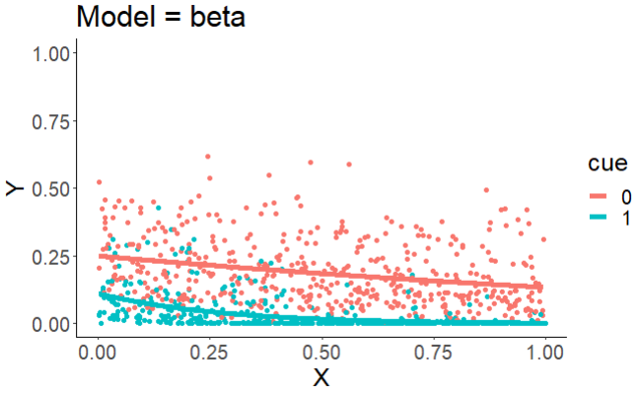
Example:
8.67
10.2

Slide 20
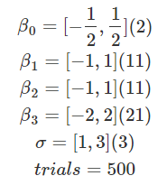

Slide 21
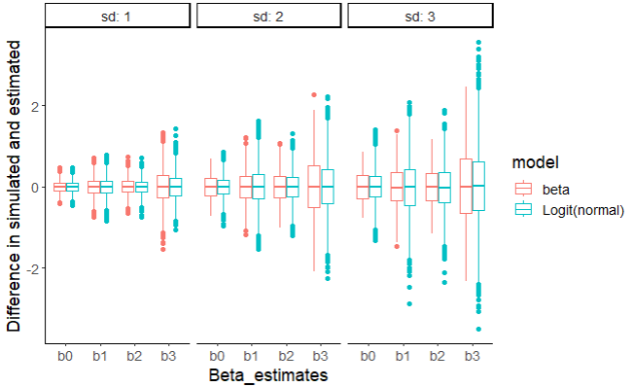
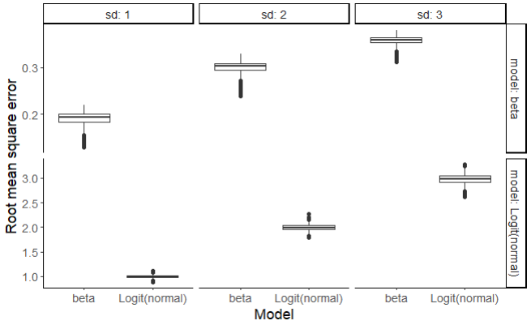

Slide 22
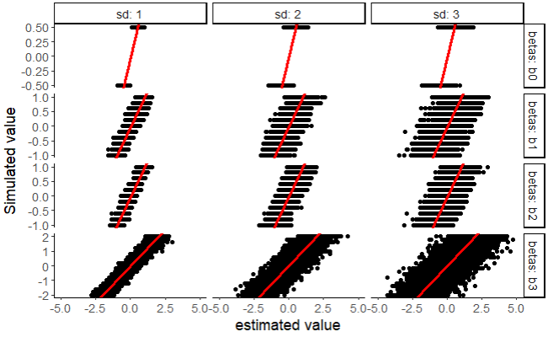
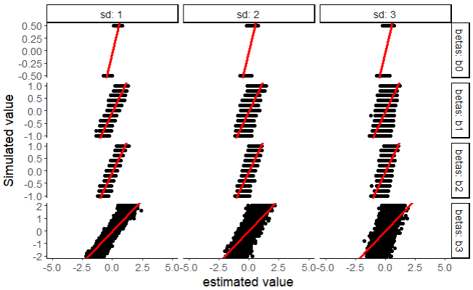
Example:

Slide 23
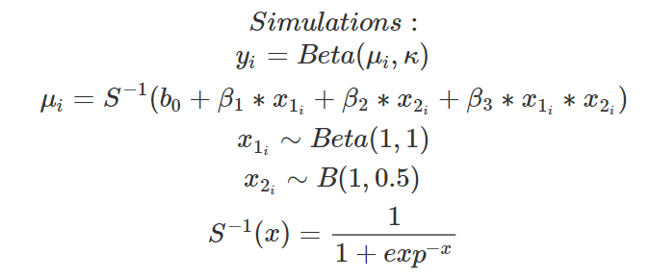
Comparing bounded distributions! (VAS)
Notes:
This is on beta dsitribution data!
https://en.wikipedia.org/wiki/Exponential_family https://lindeloev.github.io/shiny-rt/ https://stats.stackexchange.com/questions/67547/when-to-use-gamma-glms

Slide 24
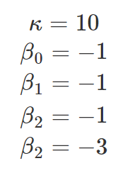
Example:
8.67
10.2

Slide 25
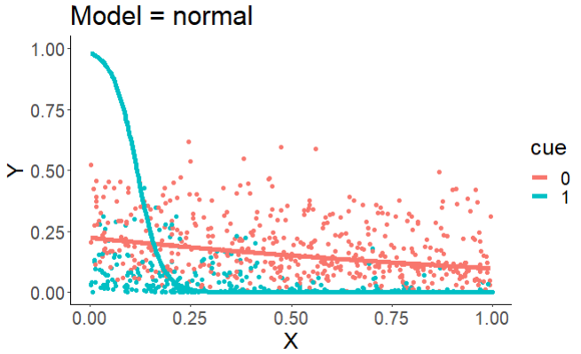
Example:
8.67
10.2

Slide 26
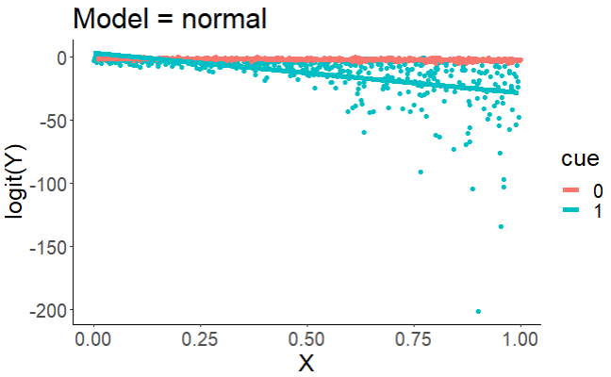
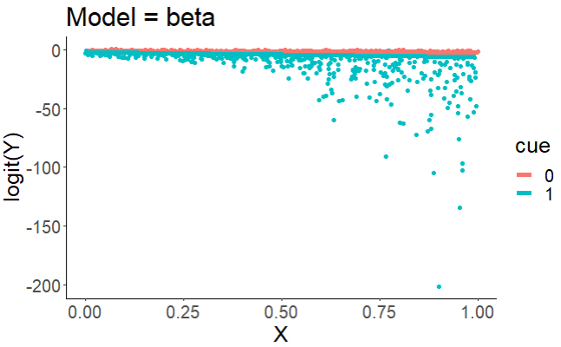
Example:
8.67
10.2

Slide 27
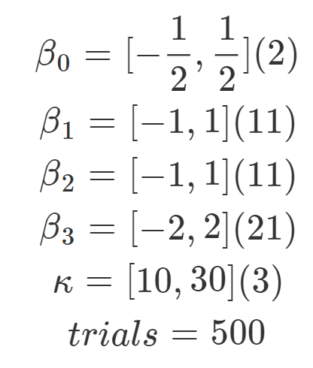

Slide 28
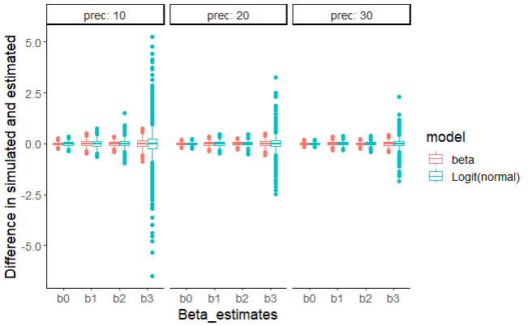
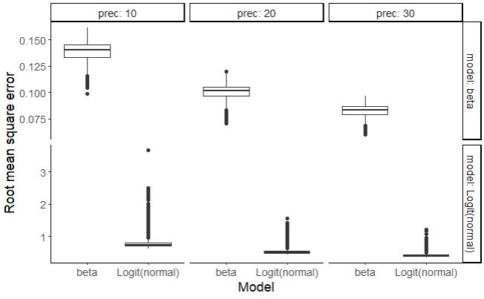

Slide 29
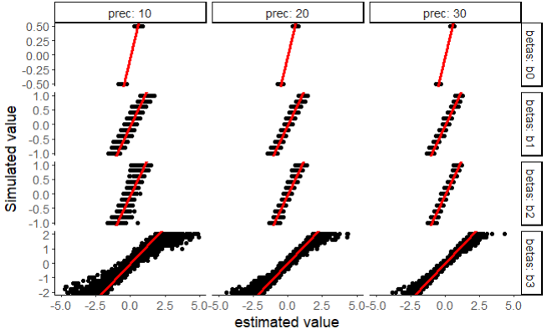
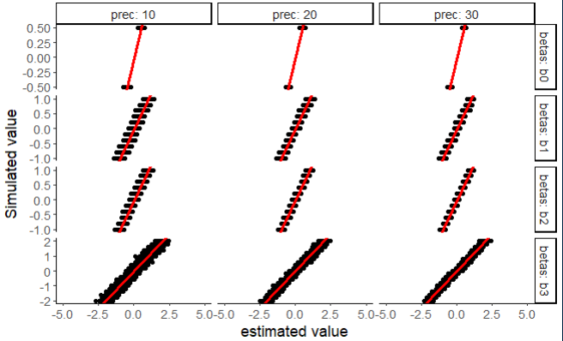

Slide 30
Further reads
https://stats.stackexchange.com/questions/573817/logit-glm-and-logit-beta-regression-practical-difference-in-the-interpretation
https://esajournals.onlinelibrary.wiley.com/doi/full/10.1002/ecs2.3940
found that people are generally using beta regression more and more and they also recommend that.
Notes:
Claiming that this is better than using a weird arcsin(sqrt(y)) transformation that people apparently use.

Slide 31
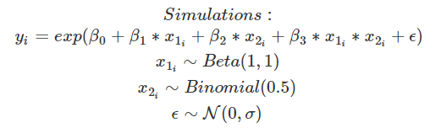
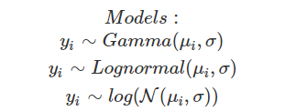
Comparing positive distributions! (Rts)
Notes:
https://en.wikipedia.org/wiki/Exponential_family

Slide 32
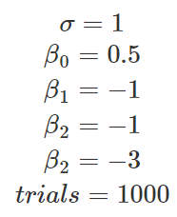
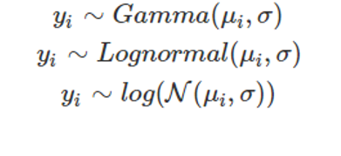
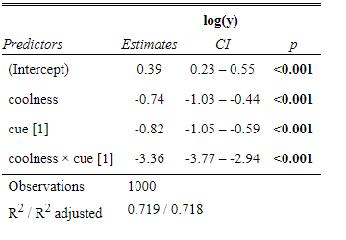
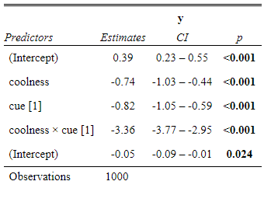
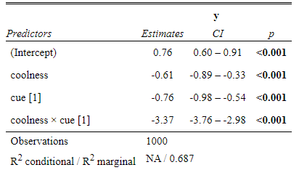
Example:
0.89
0.95

Slide 33
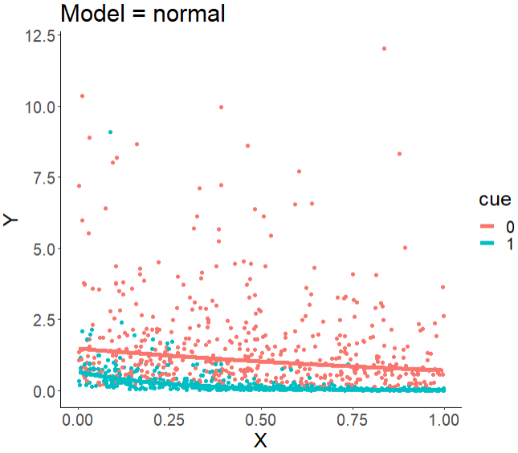
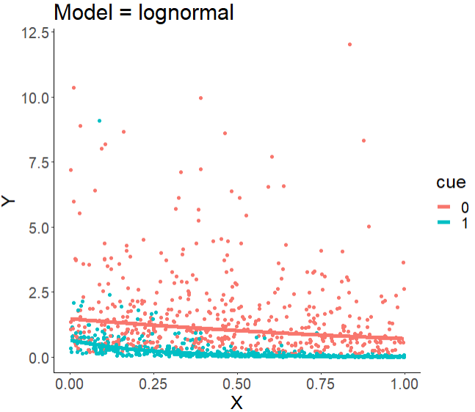

Example:

Slide 34
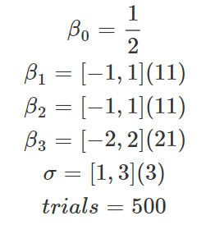

Slide 35
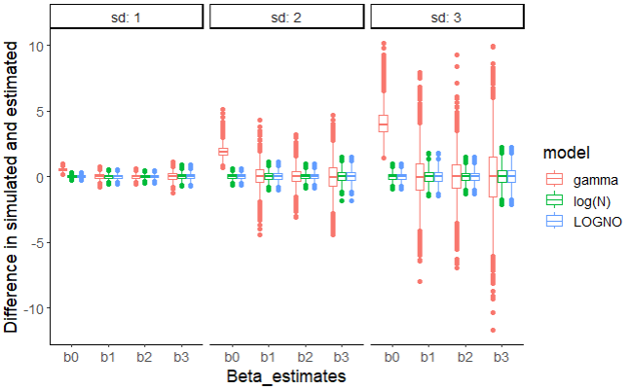
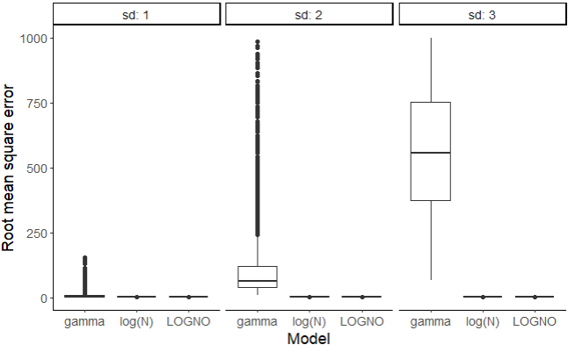

Slide 36
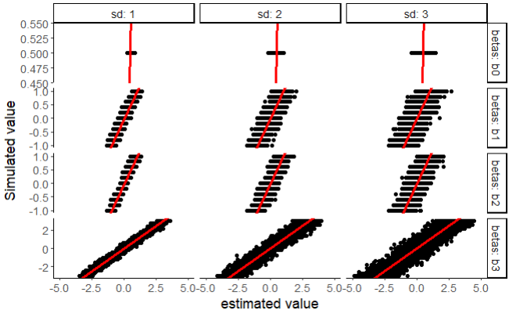
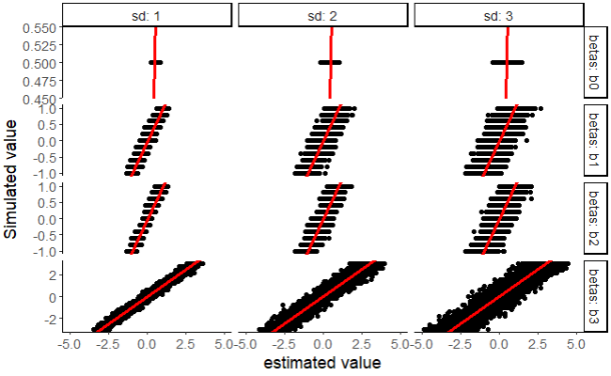

Slide 37
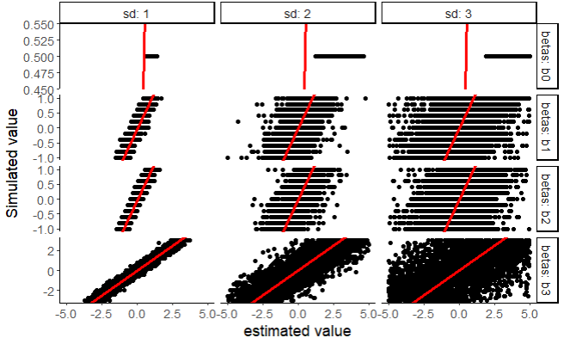

Slide 38
Further reads
Difference between lognormal and gamma distribution.
https://eric.ed.gov/?id=ED607605
https://stats.stackexchange.com/questions/72381/gamma-vs-lognormal-distributions
(lognormal more right skewed for given coefficient of variation (sd/mean) (more mass to the left))
Reaction time distributions and a cool guide
https://lindeloev.github.io/shiny-rt/
Notes:
https://www.r-bloggers.com/2020/02/log-transform-or-log-link-and-confounding-variables-by-ellis2013nz/

Slide 39




So, what to do when modeling?
tab_model(model)
Package: sjPlot
Sigma(model)
Some TPL data for the following model:
gamma
lognormal
normal
0.89
0.86
0.58
Notes:
https://cran.r-project.org/web/packages/DHARMa/vignettes/DHARMa.html
Ks test is a test for usage of the right distribution
GL(M)Ms often display over/underdispersion, which means that residual variance is larger/smaller than expected under the fitted model.
Dispersion is a property of the residuals, i.e. you can detect dispersion problems only AFTER fitting the model. It doesn’t make sense to look at the dispersion of your response variable
Overdispersion is more common than underdispersion
If overdispersion is present, the main effect is that confidence intervals tend to be too narrow, and p-values to small, leading to inflated type I error. The opposite is true for underdispersion, i.e. the main issue of underdispersion is that you loose power.
A common reason for overdispersion is a misspecified model. When overdispersion is detected, one should therefore first search for problems in the model specification (e.g. by plotting residuals against predictors with DHARMa), and only if this doesn’t lead to success, overdispersion corrections such as individual-level random effects or changes in the distribution should be applied

Slide 40



So, what to do when modeling?
Plot(simulateResiduals(model)
Package: DHARMa
TPL data for the following model:
gamma
lognormal
normal
Notes:
https://cran.r-project.org/web/packages/DHARMa/vignettes/DHARMa.html
Ks test is a test for usage of the right distribution
GL(M)Ms often display over/underdispersion, which means that residual variance is larger/smaller than expected under the fitted model.
Dispersion is a property of the residuals, i.e. you can detect dispersion problems only AFTER fitting the model. It doesn’t make sense to look at the dispersion of your response variable
Overdispersion is more common than underdispersion
If overdispersion is present, the main effect is that confidence intervals tend to be too narrow, and p-values to small, leading to inflated type I error. The opposite is true for underdispersion, i.e. the main issue of underdispersion is that you loose power.
A common reason for overdispersion is a misspecified model. When overdispersion is detected, one should therefore first search for problems in the model specification (e.g. by plotting residuals against predictors with DHARMa), and only if this doesn’t lead to success, overdispersion corrections such as individual-level random effects or changes in the distribution should be applied

Slide 41

So, what to do when modeling?
TPL data for the following model:
gamma
lognormal
normal
Notes:
https://cran.r-project.org/web/packages/DHARMa/vignettes/DHARMa.html

Slide 42



So, what to do when modeling?
testDispersion(simulateResiduals(model)
Package: DHARMa
TPL data for the following model:
gamma
lognormal
normal
Notes:
https://cran.r-project.org/web/packages/DHARMa/vignettes/DHARMa.html
Ks test is a test for usage of the right distribution
GL(M)Ms often display over/underdispersion, which means that residual variance is larger/smaller than expected under the fitted model.
Dispersion is a property of the residuals, i.e. you can detect dispersion problems only AFTER fitting the model. It doesn’t make sense to look at the dispersion of your response variable
Overdispersion is more common than underdispersion
If overdispersion is present, the main effect is that confidence intervals tend to be too narrow, and p-values to small, leading to inflated type I error. The opposite is true for underdispersion, i.e. the main issue of underdispersion is that you loose power.
A common reason for overdispersion is a misspecified model. When overdispersion is detected, one should therefore first search for problems in the model specification (e.g. by plotting residuals against predictors with DHARMa), and only if this doesn’t lead to success, overdispersion corrections such as individual-level random effects or changes in the distribution should be applied

Slide 43



So, what to do when modeling?
testUniformity(simulateResiduals(model)
Package: DHARMa
TPL data for the following model:
gamma
lognormal
normal
Notes:
https://cran.r-project.org/web/packages/DHARMa/vignettes/DHARMa.html
Ks test is a test for usage of the right distribution
GL(M)Ms often display over/underdispersion, which means that residual variance is larger/smaller than expected under the fitted model.
Dispersion is a property of the residuals, i.e. you can detect dispersion problems only AFTER fitting the model. It doesn’t make sense to look at the dispersion of your response variable
Overdispersion is more common than underdispersion
If overdispersion is present, the main effect is that confidence intervals tend to be too narrow, and p-values to small, leading to inflated type I error. The opposite is true for underdispersion, i.e. the main issue of underdispersion is that you loose power.
A common reason for overdispersion is a misspecified model. When overdispersion is detected, one should therefore first search for problems in the model specification (e.g. by plotting residuals against predictors with DHARMa), and only if this doesn’t lead to success, overdispersion corrections such as individual-level random effects or changes in the distribution should be applied

Slide 44



So, what to do when modeling?
Package: glmmTMB
Notes:
https://cran.r-project.org/web/packages/DHARMa/vignettes/DHARMa.html
Ks test is a test for usage of the right distribution
GL(M)Ms often display over/underdispersion, which means that residual variance is larger/smaller than expected under the fitted model.
Dispersion is a property of the residuals, i.e. you can detect dispersion problems only AFTER fitting the model. It doesn’t make sense to look at the dispersion of your response variable
Overdispersion is more common than underdispersion
If overdispersion is present, the main effect is that confidence intervals tend to be too narrow, and p-values to small, leading to inflated type I error. The opposite is true for underdispersion, i.e. the main issue of underdispersion is that you loose power.
A common reason for overdispersion is a misspecified model. When overdispersion is detected, one should therefore first search for problems in the model specification (e.g. by plotting residuals against predictors with DHARMa), and only if this doesn’t lead to success, overdispersion corrections such as individual-level random effects or changes in the distribution should be applied

Slide 45

So, what to do when modeling?
Package: glmmTMB
TPL data for the following model:
Notes:
https://cran.r-project.org/web/packages/DHARMa/vignettes/DHARMa.html
Ks test is a test for usage of the right distribution
GL(M)Ms often display over/underdispersion(here), which means that residual variance is larger/smaller than expected under the fitted model.
Dispersion is a property of the residuals, i.e. you can detect dispersion problems only AFTER fitting the model. It doesn’t make sense to look at the dispersion of your response variable
Overdispersion is more common than underdispersion
If overdispersion is present, the main effect is that confidence intervals tend to be too narrow, and p-values to small, leading to inflated type I error. The opposite is true for underdispersion, i.e. the main issue of underdispersion is that you loose power.
A common reason for overdispersion is a misspecified model. When overdispersion is detected, one should therefore first search for problems in the model specification (e.g. by plotting residuals against predictors with DHARMa), and only if this doesn’t lead to success, overdispersion corrections such as individual-level random effects or changes in the distribution should be applied

Slide 46

So, what to do when modeling?
Package: glmmTMB
TPL data for the following model:
Notes:
Ks test is a test for usage of the right distribution
GL(M)Ms often display over/underdispersion, which means that residual variance is larger/smaller than expected under the fitted model.
Dispersion is a property of the residuals, i.e. you can detect dispersion problems only AFTER fitting the model. It doesn’t make sense to look at the dispersion of your response variable
Overdispersion is more common than underdispersion
If overdispersion is present, the main effect is that confidence intervals tend to be too narrow, and p-values to small, leading to inflated type I error. The opposite is true for underdispersion, i.e. the main issue of underdispersion is that you loose power.
A common reason for overdispersion is a misspecified model. When overdispersion is detected, one should therefore first search for problems in the model specification (e.g. by plotting residuals against predictors with DHARMa), and only if this doesn’t lead to success, overdispersion corrections such as individual-level random effects or changes in the distribution should be applied

Slide 47
Futher reads
https://cran.r-project.org/web/packages/DHARMa/vignettes/DHARMa.html

Slide 48

Distributional regression
https://journals.sagepub.com/doi/full/10.1177/1471082X18759140?casa_token=LTve635ACQYAAAAA%3A6m3e3rL4XYfUDYAKl8cCTlSNqD1mF3Eo0GO83s4-clnQQMFgeTE4j9qQYy5EYTPqGgnEZwwA8e3v

Slide 49



Slide 50



Slide 51



Assumptions
QQ-plot
Histogram of residuals
1.04
Notes:
It should be mentioned that either way of looking at this how the error-term is conceptualized doesn’t matter if it’s a normal distribution with a mean and a standard deviation then a mean would just be reflected in the intercept of the linear model.

Slide 52




Assumptions
QQ-plot

Slide 53

Assumptions
QQ-plot

Slide 54

Assumptions
QQ-plot

Slide 55

Transformations. (from linear models to generalized linear models)

Slide 56

Transformations. (from linear models to generalized linear models)

Slide 57

Transformations. (from linear models to generalized linear models)

Slide 58

Making sense of it using an example.

Slide 59






Making sense of it using an example.
Modeling (lm)
Modeling (GAMLSS)
Parameters:
Parameters:

Slide 60
Making sense of it using an example.
Modeling (lm)
Modeling (GAMLSS)
Parameters:
Parameters:

Slide 61




Slide 62


Slide 63


Slide 64


Slide 65




Slide 66


Slide 67


Slide 68
Further reads
Distributional regression (technical and mathy papers)
https://arxiv.org/pdf/2307.10651.pdf
https://www.sciencedirect.com/science/article/pii/S2452306221000824
https://bmcmedresmethodol.biomedcentral.com/articles/10.1186/s12874-022-01534-8
Timeline is 2021 and forward. Everyone mentions gamlss.

Slide 69

Comparing models

Slide 70

Comparing models

Slide 71

Comparing models
AIC,DIC,LME,LRT,DIC,WAIC …..
-interaction

Slide 72

Comparing models
AIC,BIC,DIC,LME,LRT,DIC,WAIC …..
-interaction

Slide 73

Comparing models
AIC,BIC,DIC,LME,LRT,DIC,WAIC …..
-interaction

Slide 74

Comparing models
AIC,BIC,DIC,LME,LRT,DIC,WAIC …..
-interaction

Slide 75
Questions:
What models to choose, independent of independent variables.
What parameters to parameterize.
Model comparaison

Slide 76

Comparing models
AIC,BIC,DIC,LME,LRT,DIC,WAIC …..
Notes:
Here I show the range of p-values where the LRT would be non-significant. As can be seen the AIC will cut the data in half of which model is better and which is not. Whereas the BIC kind of agrees with the LRT saying that the model with the interaction is here not relevant, eventhough there is a significant p-value in the interaction itself.

